Slide 1
CRYPTEX
Kartik Prakash(E054)
Aishwarya Rao(E056)
Pranav Toggi(E058)
Priyanka Purohit(E072)

Slide 2
INTRODUCTION
The word cryptex is a word denoting a portable vault used to hide secret messages.
It is a combination of the words cryptology and codex; "an apt title for this device" since it uses "the science of cryptology to protect information written on the contained scroll or codex.

Slide 3
The Cryptex is basically an app lock designed to secure 3rd party apps on your phone using a clean interface.
The interface is clean and intuitive, making it easy even for novice users to protect their data.
The Cryptex lists alphabetically all the installed on your phone; simply scroll down and toggle on protection for specific apps where required. You can also use the search field to quickly find an app.

Slide 4
Hardware specifications Software specifications
Optimized for 5.5” touchscreen.
RAM required: 512 MB
Min: Android v 4.4.2 kitkat
Internet Connection

Slide 5
FEATURES

Slide 6
The locked application can be opened in two ways :
Using pin
Combinational tap code

Slide 7
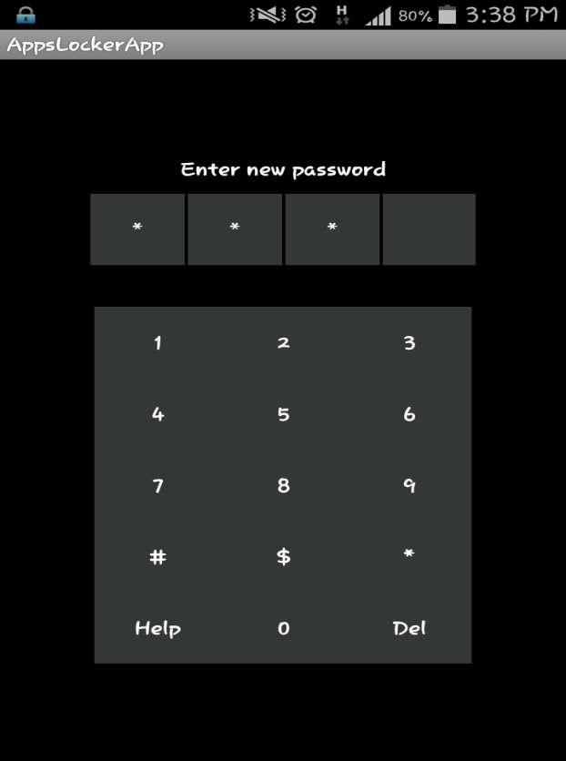
Using pin
This is the primary method to unlock the app.
Pin can be retrieved by using ‘forgot pin’ option.
A 4-digit numerical combination is entered to unlock the app.
This combination can be changed anytime by the user in the settings of cryptex.

Slide 8
Combinational tap code
The secondary method of unlocking the app is the combinational tap code.
This method ensures high security than the pin.
Distinguishes the app from other app locks in the market.
Data needing higher protection can be protected using this method.

Slide 9
Security
The user’s privacy is the app’s utmost priority.
It eliminates the possibility of brute force hacking by blocking the password window for 60 seconds after 3 incorrect password entries.
To retrieve the forgotten password, an email containing a new self generated password will be sent to the user.

Slide 10
Scope
Future improvements that can be made-
Facial recognition
Gesture driven unlocking
Fingerprint unlocking

Slide 11
Target Audience
The app focusses on users who want to protect their data with top notch security especially-
Students
business class
Hostel residents

Slide 12
The themes of the lock can be changed as per user’s request.
The user can decide which apps are suppose to be locked.
If the screen gets locked, then the app also gets locked.

Slide 13
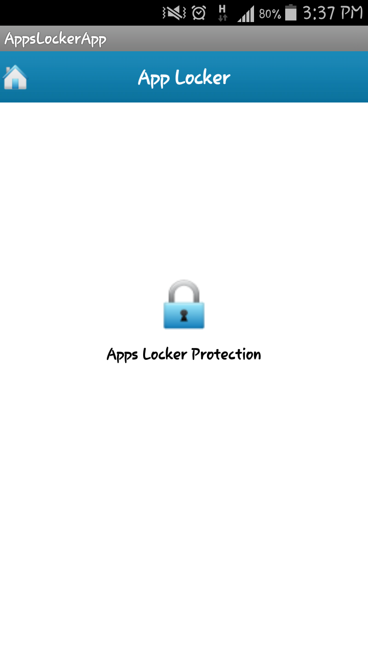
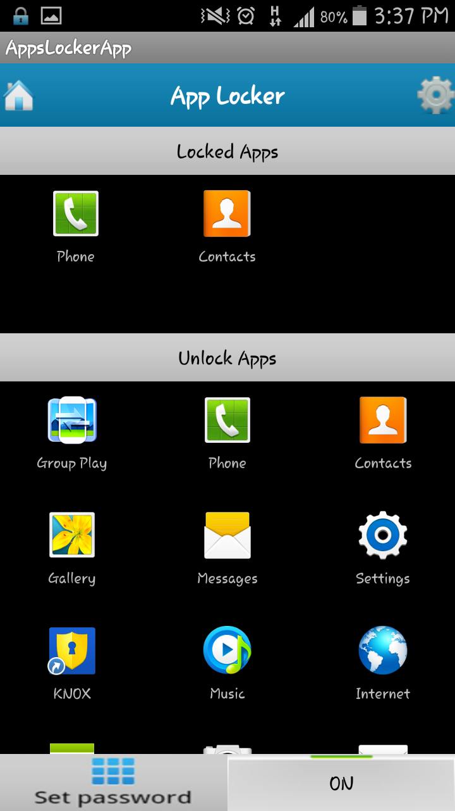

Slide 14


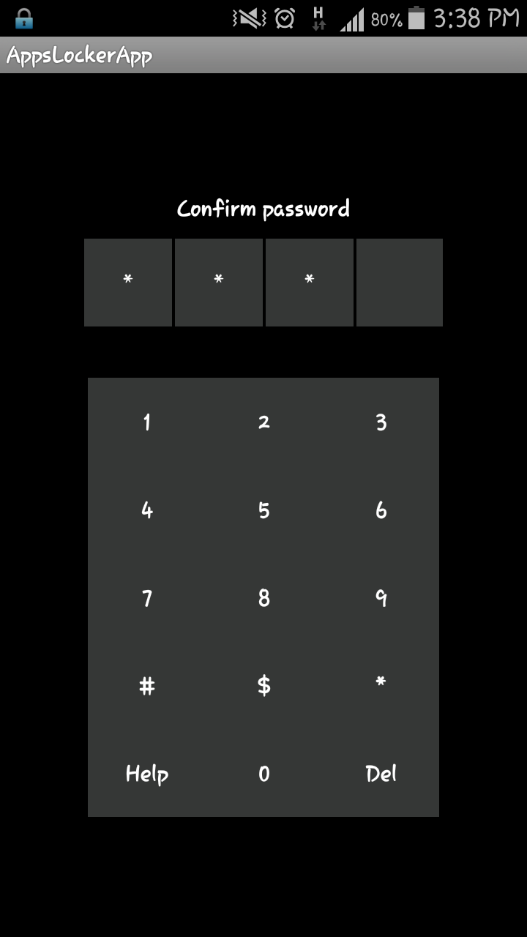

Slide 15
Thank You

